Slide 1
FINAL PROJECT
Subject: Fundamentals of Programming
Format: Project
Instructor: Zhangir Rayev Presenter: Abishov Nurtileu

Slide 2

My project
Telegram BOT
Name: QazaQ_Bot
Username: @qazaqman_bot

Slide 3
PLAN FOR CREATING A TELEGRAM BOT
01
02
PIP
Writing codes
03
04
ANALYSIS
Run the program
Working with libraries
Completing code writing

Slide 4
Libraries
01.
Working with the library, working with codes in a certain direction
02.
The advantage of a telegram bot is that it can communicate in all directions

Slide 5
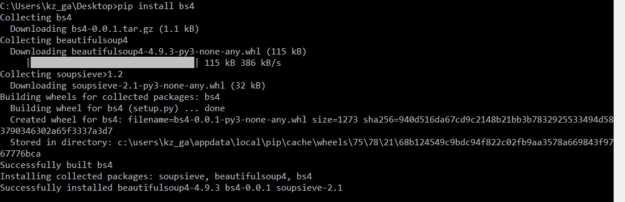
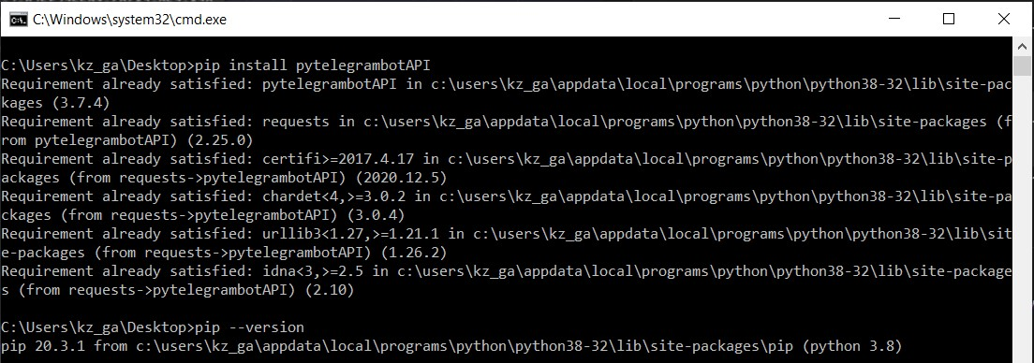
1 pip bs4 for working with pars
2nd picture pip TelegramBotAPI

Slide 6
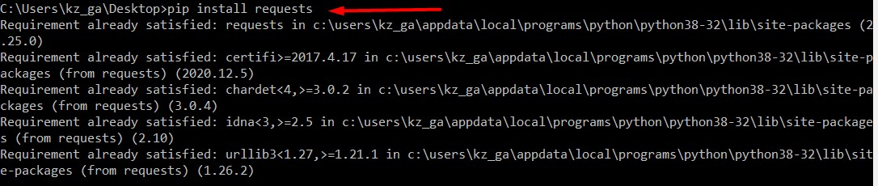
3rd is pip requests

Slide 7
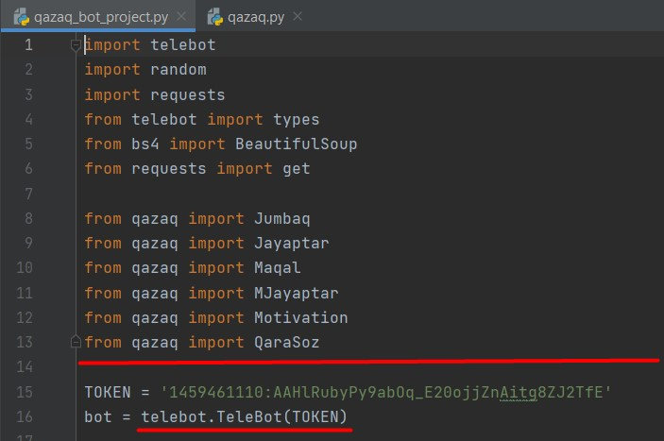
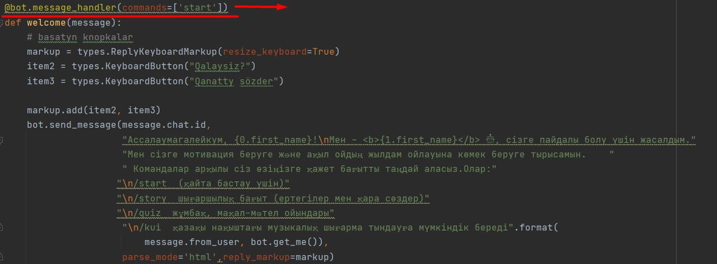

Slide 8
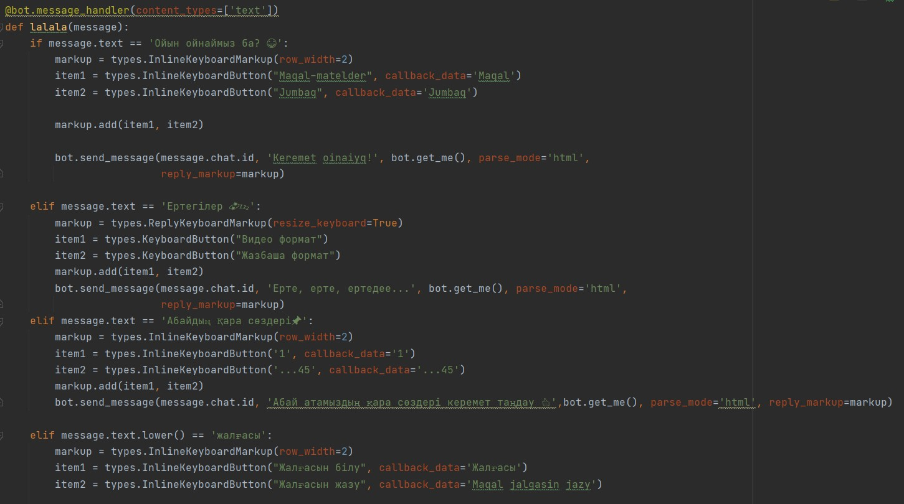

Slide 9
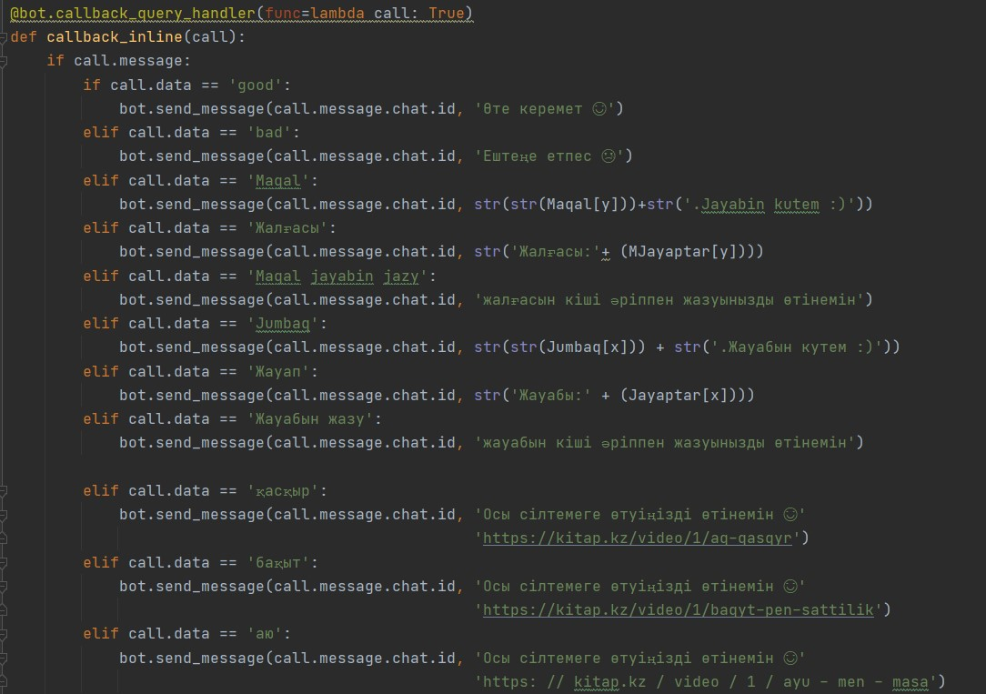

Slide 10
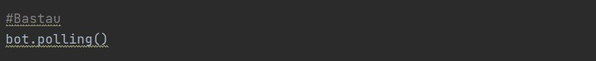
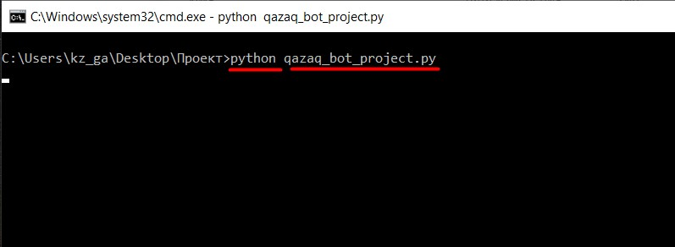
RUN PROGRAM
RUN WITH CMD CONSOLE

Slide 11
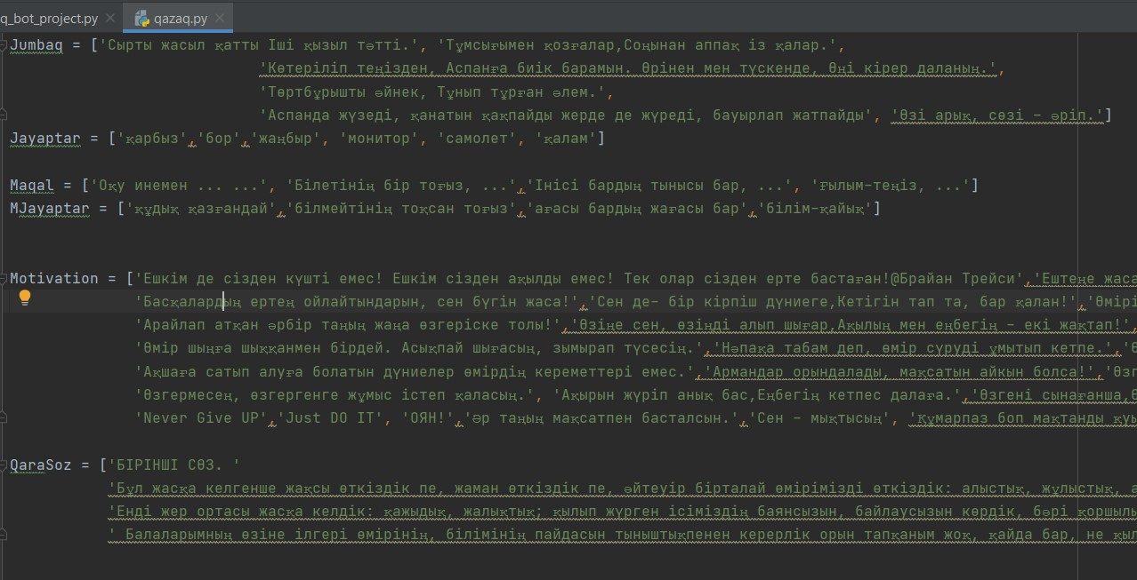
Additive
AUTHOR (YEAR). Title of the publication. Publisher
AUTHOR (YEAR). Title of the publication. Publisher
AUTHOR (YEAR). Title of the publication. Publisher
AUTHOR (YEAR). Title of the publication. Publisher
AUTHOR (YEAR). Title of the publication. Publisher
AUTHOR (YEAR). Title of the publication. Publisher

Slide 12
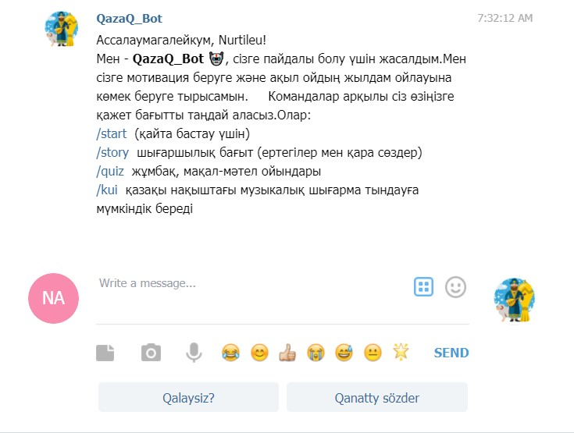
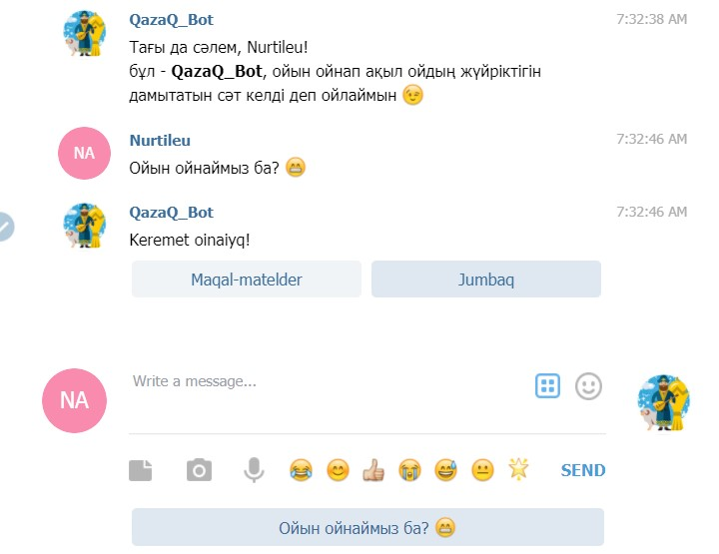
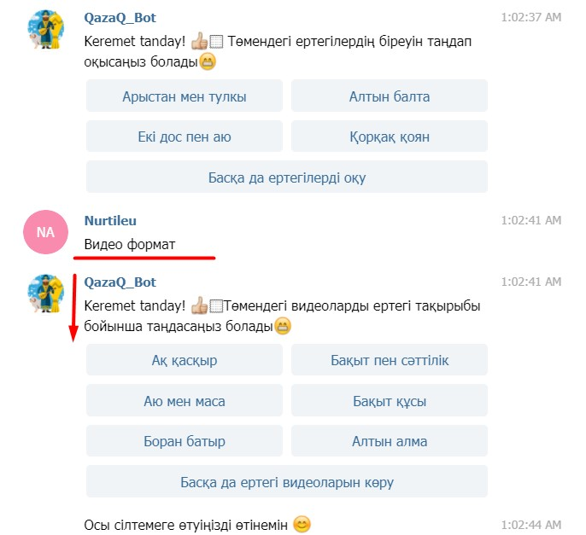
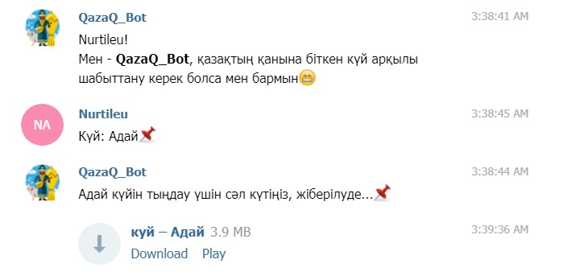

Slide 13
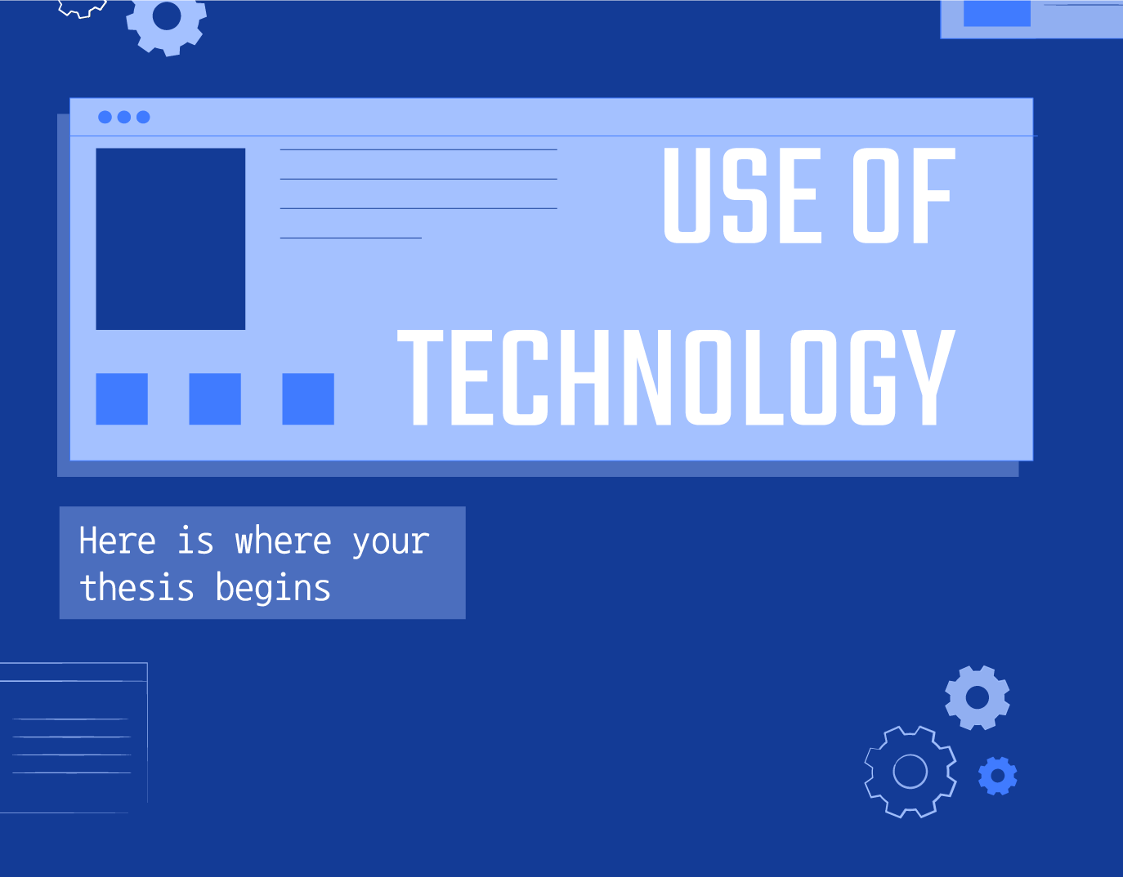
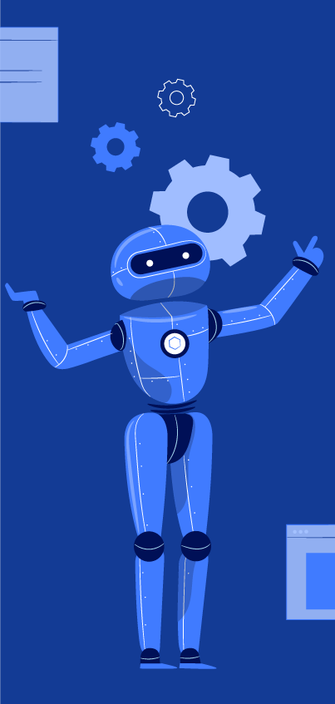
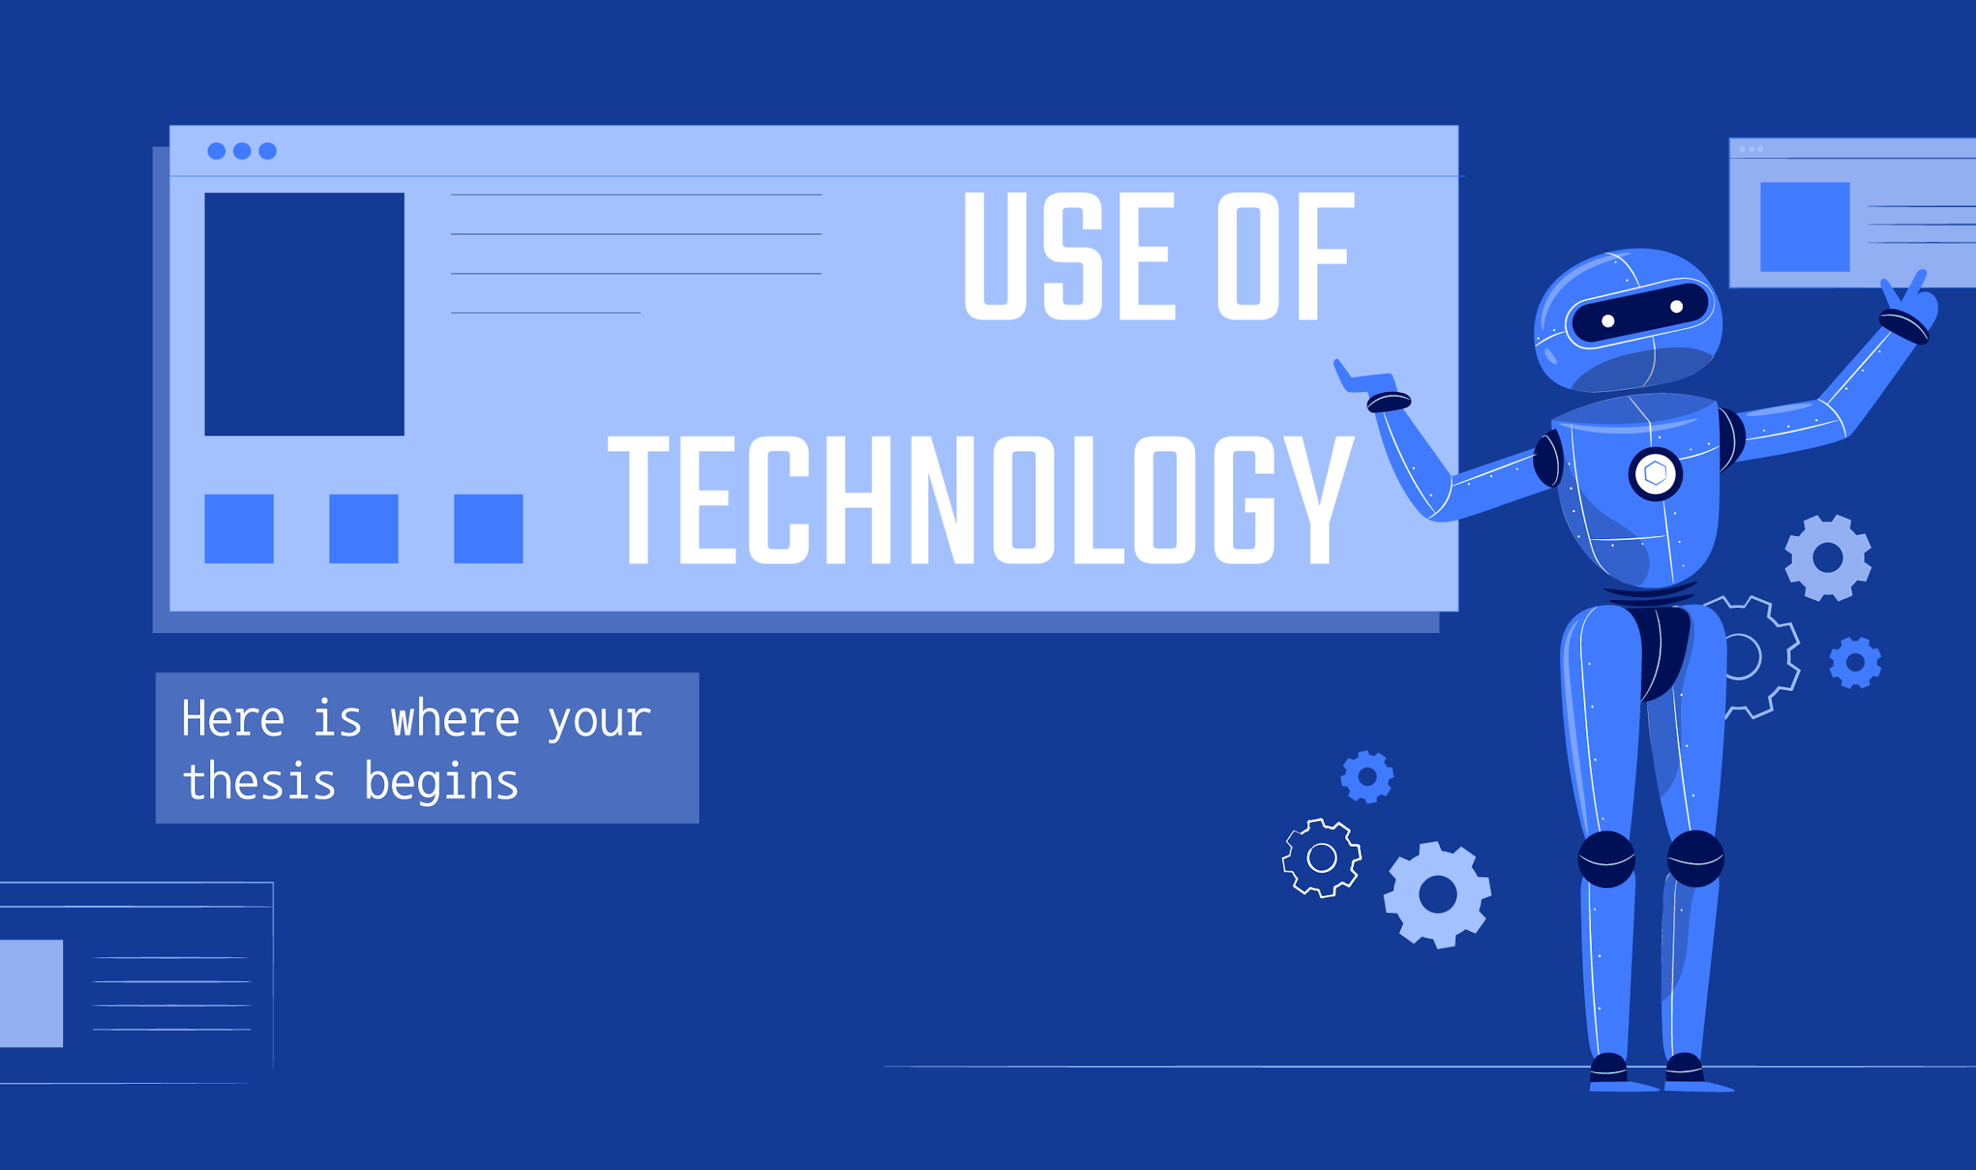
Reference list
https://core.telegram.org/bots/api
https://www.youtube.com/watch?v=M8fhrtvedHA

Slide 14
THANKS
Does anyone have any questions?
Nurtileu ABishov
200101053@stu.sdu.edu.kz
Please keep this slide for attribution

